Slide 1
Grading criteria
The following criteria will be applied in the grading of written contributions:
Ability to express discussed content/one‘s own thoughts clearly and precisely
Argumentative consistency
Capacity to independent critical reflection

Slide 2
Program for today‘s session
07/03/2019
Recapitulation of first session
3 modes of inference: deduction, induction, (abduction)
Hume’s problem of induction (incl. task 2)
The DN-model of explanation and the symmetry thesis
Darwin’s explanatory theory of evolution
Prediction in “irregular subjects”

Slide 3
Two Senses of “Prediction”
1. General-epistemic
“Prediction” refers to the process of using specific inferential tools (theoretical reasoning, induction, fortune telling etc.) to generate new information (which has not yet been ascertained by more direct means) from available knowledge.
2. Literal-temporal
A prediction is temporal if the newly generated information pertains to future events/states of affairs.
2. is a subspecies of 1.

Slide 4
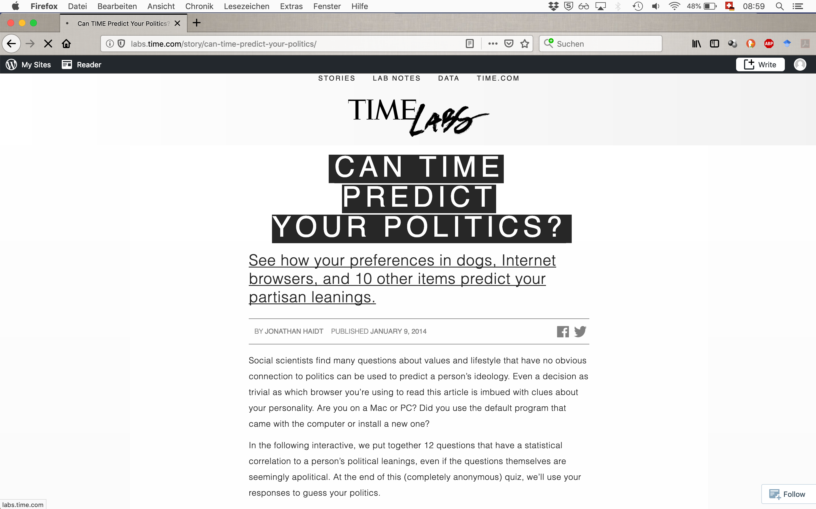

Slide 5
Types of Inferences
Deduction
All the beans in this bag are white
These beans are from this bag
-------------------------------------------------
These beans are white
Properties:
The truth of the premises warrants the truth of the conclusion.
In a deductively valid argument, it is impossible that the premises are true and the conclusion is false.
Logically necessary
Not ampliative (“analytic”)
A deductive argument is called „sound“ if its premises happen to be true.
Induction
These beans are white
These beans are from this bag
-------------------------------------------------
All the beans in this bag are white
Properties:
The truth of the premises does not warrant the truth of the conclusion.
It is possible that the premises are true and the conclusion is false.
Not necessary
Ampliative (”synthetic”)
Abduction
(Peirce: „Hypothesis“)
All the beans in this bag are white
These beans are white
-------------------------------------------------
These beans are from this bag
Properties:
The truth of the premises does not warrant the truth of the conclusion.
It is possible that the premises are true and the conclusion is false.
Not necessary
Ampliative (”synthetic”)
The conclusion „explains“ the premises.
Inference to the best explanation
C. S. Peirce, Deduction, Induction, Hypothesis (1878)

Slide 6
The analytic/synthetic distinction
Analytic statements: True/false by virtue of the meaning of terms. Negation leads to contradiction.
Examples: Triangles have three angles. Bachelors are unmarried men.
Synthetic statements: Truth/falsehood depends on empirical matters of fact. Negation does not lead to contradiction.
Examples: Paris is the capital of France. France has the largest oil reserves on the planet. The sun will raise tomorrow.
a priori statements: Verification does not require experience
a posteriori statements: Verification requires experience
 | analytic | synthetic
A priori | x x | x
A posteriori |  | x x
x: Empiricism x: Rationalism

Slide 7
Hume on causality
„Here is a billiard-ball lying on the table, and another ball moving towards it with rapidity. They strike; and the ball, which was formerly at rest, now acquires a motion. This is as perfect an instance of the relation of cause and effect as any which we know, either by sensation or by reflection. Let us therefore examine it. ’Tis evident, that the two balls touched one another before the motion was communicated, and that there was no interval betwixt the shock and the motion. Contiguity in time and place is therefore a requisite circumstance to the operation of all causes. ’Tis evident likewise, that the motion, which was the cause, is prior to the motion, which was the effect. Priority in time, is therefore another requisite circumstance in every cause. But this is not all. Let us try any other balls of the same kind in a like situation, and we shall always find, that the impulse of the one produces motion in the other. Here therefore is a third circumstance, viz., that is a constant conjunction betwixt the cause and effect. Every object like the cause, produces always some object like the effect. Beyond these three circumstances of contiguity, priority, and constant conjunction, I can discover nothing in this cause. The first ball is in motion; touches the second; immediately the second is in motion: and when I try the experiment with the same or like balls, in the same or like circumstances, I find that upon the motion and touch of the one ball, motion always follows in the other. In whatever shape I turn this matter, and however I examine it, I can find nothing farther.“
(An Enquiry Concerning Human Understanding, Abstract of a Treatise of Human Nature)

Slide 8
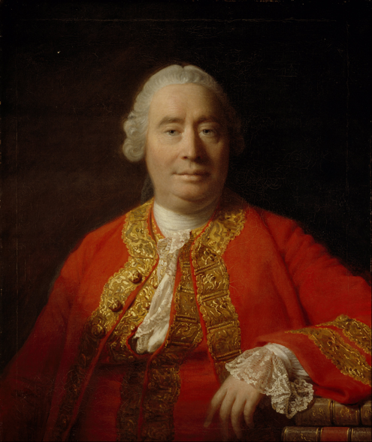
David Hume and the Problem of Induction
Reasoning that goes beyond past and present is based on cause and effect
The relation of causality:
1) constant conjunction
2) contiguity
3) priority in time (of the cause)
4) NO necessary connection!!!!
David Hume
1711–1776
The Problem of Induction:
How can inferences from the past/present to the future (or from observed instances to unobserved instances) be justified?
(Hume’s answer: They can’t!)

Slide 9
Hempel & Oppenheim’s deductive-nomological model of scientific explanation
Distinction between “why?” and “what?”-questions
«To explain the phenomena in the world of our experience, to answer the question "why?" rather than only the question "what?", is one of the foremost objectives of all rational inquiry; and especially, scientific research in its various branches strives to go beyond a mere description of its subject matter by pro- viding an explanation of the phenomena it investigates. While there is rather general agreement about this chief objective of science, there exists considerable difference of opinion as to the function and the essential characteristics of scientific explanation.» (p. 135)

Slide 10
Hempel & Oppenheim’s deductive-nomological model of scientific explanation (cont.)
Schema of a DN-explanation

Slide 11
Hempel & Oppenheim’s deductive-nomological model of scientific explanation (cont.)
Logical conditions of adequacy
R1 The explanandum must be a logical consequence of the explanans.
R2 The explanans must contain general laws and these must actually be required for the derivation of the explanandum.
R3 The explanans must have empirical content, i.e. the laws it contains must be capable of empirical tests.
Empirical condition of adequacy
R4 The explanans must be true.

Slide 12
Hempel & Oppenheim’s deductive-nomological model of scientific explanation (cont.)
Symmetry thesis

Slide 13
Hempel & Oppenheim’s deductive-nomological model of scientific explanation (cont.)
Counterexamples
The flagpole (Bromberger 1966)
The length of the shade of a flagpole can be DN-explained But so can the length of the flagpole.
→ Hempel & Oppenheim’s model is too inclusive.
The birth-pill (Salmon 1971)
His regular intake of birth-pills explains why John Jones did not get pregnant.
→ The DN-model is unable to single out relevant causal factors. It does not provide criteria for relevance.

Slide 14
Program for today‘s session
14/03/2019
The DN-model of explanation and the symmetry thesis (cont.)
Darwin’s explanatory theory of evolution (incl. task 3)
Prediction in “irregular subjects”
Popper’s falsificationism
Popper’s The Poverty of Historicism

Slide 16
Scriven (1959), Explanation and Prediction in Evolutionary Theory
Irregular subjects (p. 477). They explain, but actual prediction is precluded (parts of biology, psychology, anthropology, history, cosmogony, engineering, economics, quantum physics).
Hypothetical probability predictions (p. 478). Example: Species (or individuals) that are better swimmers are more likely to survive a flood. Not useful for actual prediction. Not easily falsified by observation.
Against symmetry (p. 480). Prediction requires only a correlation, explanation requires more (i.e. causes). We can make predictions from indicators. → We can sometimes predict what we cannot explain. What about the other way around?
Retrospective Causal Analysis (p. 480). Example: a skin cancer case. → Post hoc explanation with no “in principle” possibility of prediction

Slide 17
Objective vs. Subjective Interpretations of Probability
Objective interpretation
Probability statements are truth-valued statements about the world. Their truth-makers are facts, i.e. objective frequencies.
Objective frequencies can be measured in statistical experiments.
Typical Examples: Dice rolling; the frequency of achromatopsia in the Swiss population
Subjective interpretation
Probability statements are statements about the uttering subject’s degree of belief.
Subjective probabilities are a measure of the subject’s uncertainty about the statement.
Typical Examples: betting odds; hypothetical probability predictions (?)
“The probability of E is p.”
Two interpretations:
p is an objective property of E
S believes that the probability of E is p

Slide 18
Program for today‘s session
21/03/2019
Prediction in “irregular subjects” & hypothetical probability predictions (recap)
Popper’s falsificationism
Popper’s The Poverty of Historicism
F53

Slide 19
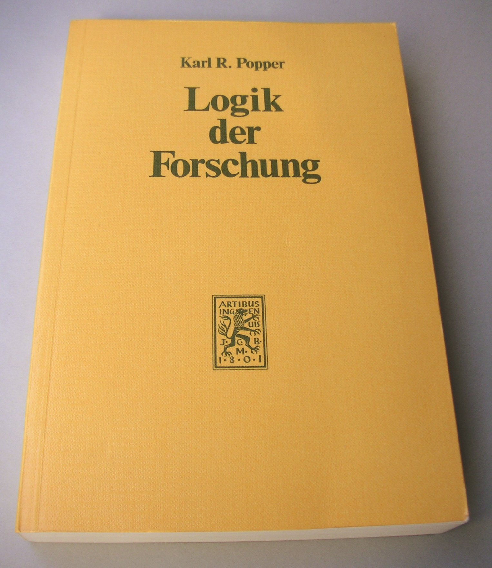
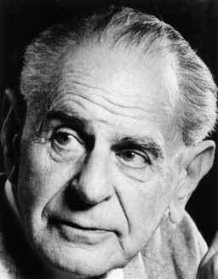
Karl Popper’s (Dis)solution of the Problem of Induction in
The Logic of Scientific Discovery (1934)
Sir Karl R. Popper
1902–1994

Slide 20
Karl Popper’s (Dis)solution of the Problem of Induction in
The Logic of Scientific Discovery (1934)
Karl R. Popper
1902–1964
The Hypothetico-Deductive Method/Falsificationism
“According to the view that will be put forward here, the method of critically testing theories, and selecting them according to the results of tests, always proceeds on the following lines. From a new idea, put up tentatively, and not yet justified in any way—an anticipation, a hypothesis, a theoretical system, or what you will—conclusions are drawn by means of logical deduction.”
I

Slide 21
Hypothetico-Deductive Method/Falsificationism (cont.)
“Next we seek a decision as regards these (and other) derived statements by comparing them with the results of practical applications and experiments. If this decision is positive, that is, if the singular conclusions turn out to be acceptable, or verified, then the theory has, for the time being, passed its test: we have found no reason to discard it. But if the decision is negative, or in other words, if the conclusions have been falsified , then their falsification also falsifies the theory from which they were logically deduced.”
II
“Nothing resembling inductive logic appears in the procedure here outlined. I never assume that we can argue from the truth of singular statements to the truth of theories. I never assume that by force of ‘verified’ conclusions, theories can be established as ‘true’, or even as merely ‘probable’.”

Slide 22
Psychology
Singular (observational) Statements
O₁, O₂ ... O_{n}
All ...
Every ...
General Statement
(Theory, Model)
Corroboration
C
Falsification
D
C₁, C₂ ... C_{n}
Observational Consequences
Logic!

Slide 23
Summary of Popper’s Falsificationism
(Critical Rationalism)
Starting Point: The problem of induction is unsolvable. BUT: Science can proceed without induction!
Distinction between Context of Discovery and Context of Justification (elimination of psychologism)
Logical Asymmetry between falsification and verification
→ Sciences progresses through the falsification of conjectural theories.
→ Theories can never be verified with certainty. They are merely corroborated to different degrees.
→ The method of science is criticism with the aim of falsification.
2 Problems (among several):
The whiff of induction
Conformational holism & legitimate ad hoc hypotheses (cf. anomalies in Uranus’ orbit)

Slide 24
Popper’s argument in The Poverty of Historicism
The course of human history is strongly influenced by the growth of human knowledge.
We cannot predict the future growth of our scientific knowledge.
We cannot, therefore, predict the future course of history.
Thus we must reject the possibility of a theoretical history. There can be no scientific theory of historical development serving as a basis for historical prediction.
Historicism must be rejected.
Def. Historicism:
“[A]n approach to the social sciences which assumes that historical prediction is their principal aim, and which assumes that this aim is attainable by discovering the ‘rhythms’ or the ‘patterns’, the ‘laws’ or the ‘trends’ that underlie the evolution of history.”

Slide 25
The Anti-Naturalistic Doctrines of Historicism
Generalization: No long-run uniformity in social history (except trivial regularities).
Experiment: Large-scale experiments in social science do not advance knowledge. Their very performance changes the conditions of society (reflexivity).
Novelty: Even if the methods of physics were applicable to society, they could not be applied to its most important feature, the emergence of novelty (no general causal laws).
Complexity: Even if there were uniformities, we might not be able to find them due to complexity.
Inexactitude of Prediction: Social prediction can have an influence on the predicted event (Oedipus effect, reflexivity).
Objectivity and Valuation: Social predictions can cause/prevent the predicted events. This destroys the objectivity of the social sciences.
Holism: Social groups/institutions are more than the sum of their parts (anti-reductionism).
Intuitive Understanding: Social sciences aim at understanding social phenomena (motivations/interests; meaning/significance of events; historical trends/tendencies)
Quantitative Methods: Qualities of social entities cannot be expressed quantitatively. No quantitative laws.
Essentialism versus Nominalism: Social Sciences must adopt methodological essentialism.

Slide 26
The distinction between prophecy and technological/engineering predictions
Two kinds of scientific prediction according to two different ways of being practical. (BUT: Not all scientific predictions are practical!)
Prophecy: The prediction of a typhoon (or a solar eclipse, or a meteorite)
    Predicted event cannot be prevented
    Practical value: warning, preparation
Technological/engeneering: A shelter is likely to stand up to a typhoon if … .
    Constructive; give guidance for actions given certain aims.
    Practical value: warning, preparation
    Typical experimental sciences allow for technological predictions
Historicists generally consider prophecy as the aim of social science, because social experiments are impossible.
In this perspective, social science is nothing but history. However not traditional history, but forward-looking, theoretical history.
→ The latter is, according to Popper, impossible (and dangerous).

Slide 27
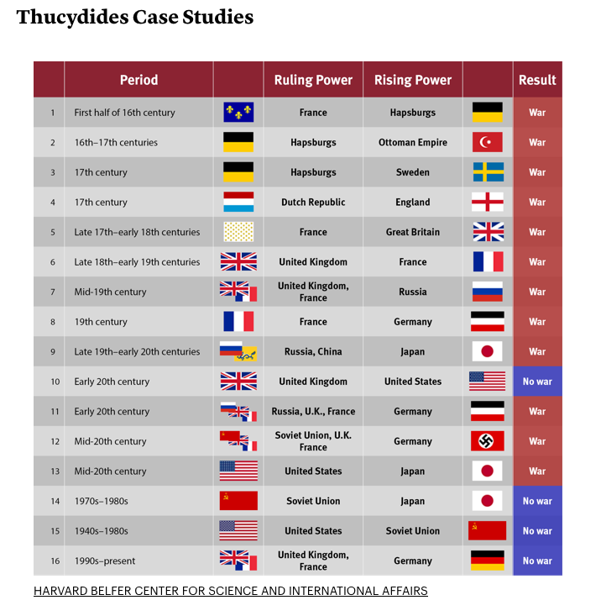
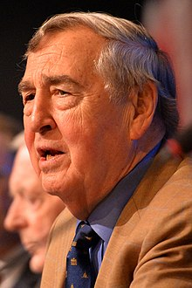
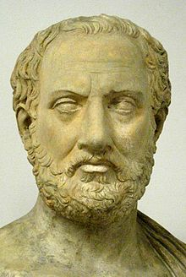
An example of ”predictive” history?:
Graham Allison’s Destined for War: Can America and China Escape Thucydides’ Trap? (2017)
«What made war inevitable was the growth of Athenian power and the fear which this caused in Sparta.»
Thucydides, The Peloponnesian War
https://www.theatlantic.com/international/archive/2015/09/united-states-china-war-thucydides-trap/406756/

Slide 28
The concept of “applied history”
Applied history is ...
“… the use of the scientific knowledge of history and experience in efforts to solve present problems of human betterment.”
Benjamin Shambaugh, The American Historical Review, 1913
“By Applied History we mean the explicit attempt to illuminate current policy challenges by analyzing historical precedents and analogues.”
Graham Allsion, The Atlantic, 2015.
Applied history re-emerged as a concept in the 1970s (esp. at Harvard)
Ernest May, Lessons of the Past': The Use and Abuse Of History in American Foreign Policy, 1974.
Richard Neustadt & Ernes May, Thinking in Time: The Uses of History for Decision-Makers, 1986.
Current proponents: Niall Ferguson, Graham T. Allison and others
Several study programs for applied history have been established in recent years
Journal of Applied History was launched in 2018.

Slide 29
Prediction and the aim(s) of science
Methodological debates about the role of predictions in science are often based on (implicit) assumptions about the aim(s) of science (in general or in specific disciplines), and whether there can be a unified and unique method that leads to the attainment of those aims.
Popper: The aim of science is to test tentative theories empirically. The method of science is hypothetico-deductive.
Darwin: The goal of natural history is to unify a wide variety of natural phenomena under one naturalistic explanation.
Experimental social psychologists: The goal of social psychology is to find correlations that can be used to predict the traits/behavior of groups/individuals. We might or we might not be able to give causal explanatory accounts of those correlations.
Friedman: Economics is positive, not normative. “The ultimate goal of a positive science is the development of a "theory" or, "hypothesis" that yields valid and meaningful (i.e., not truistic) predictions about phenomena not yet observed.”

Slide 30
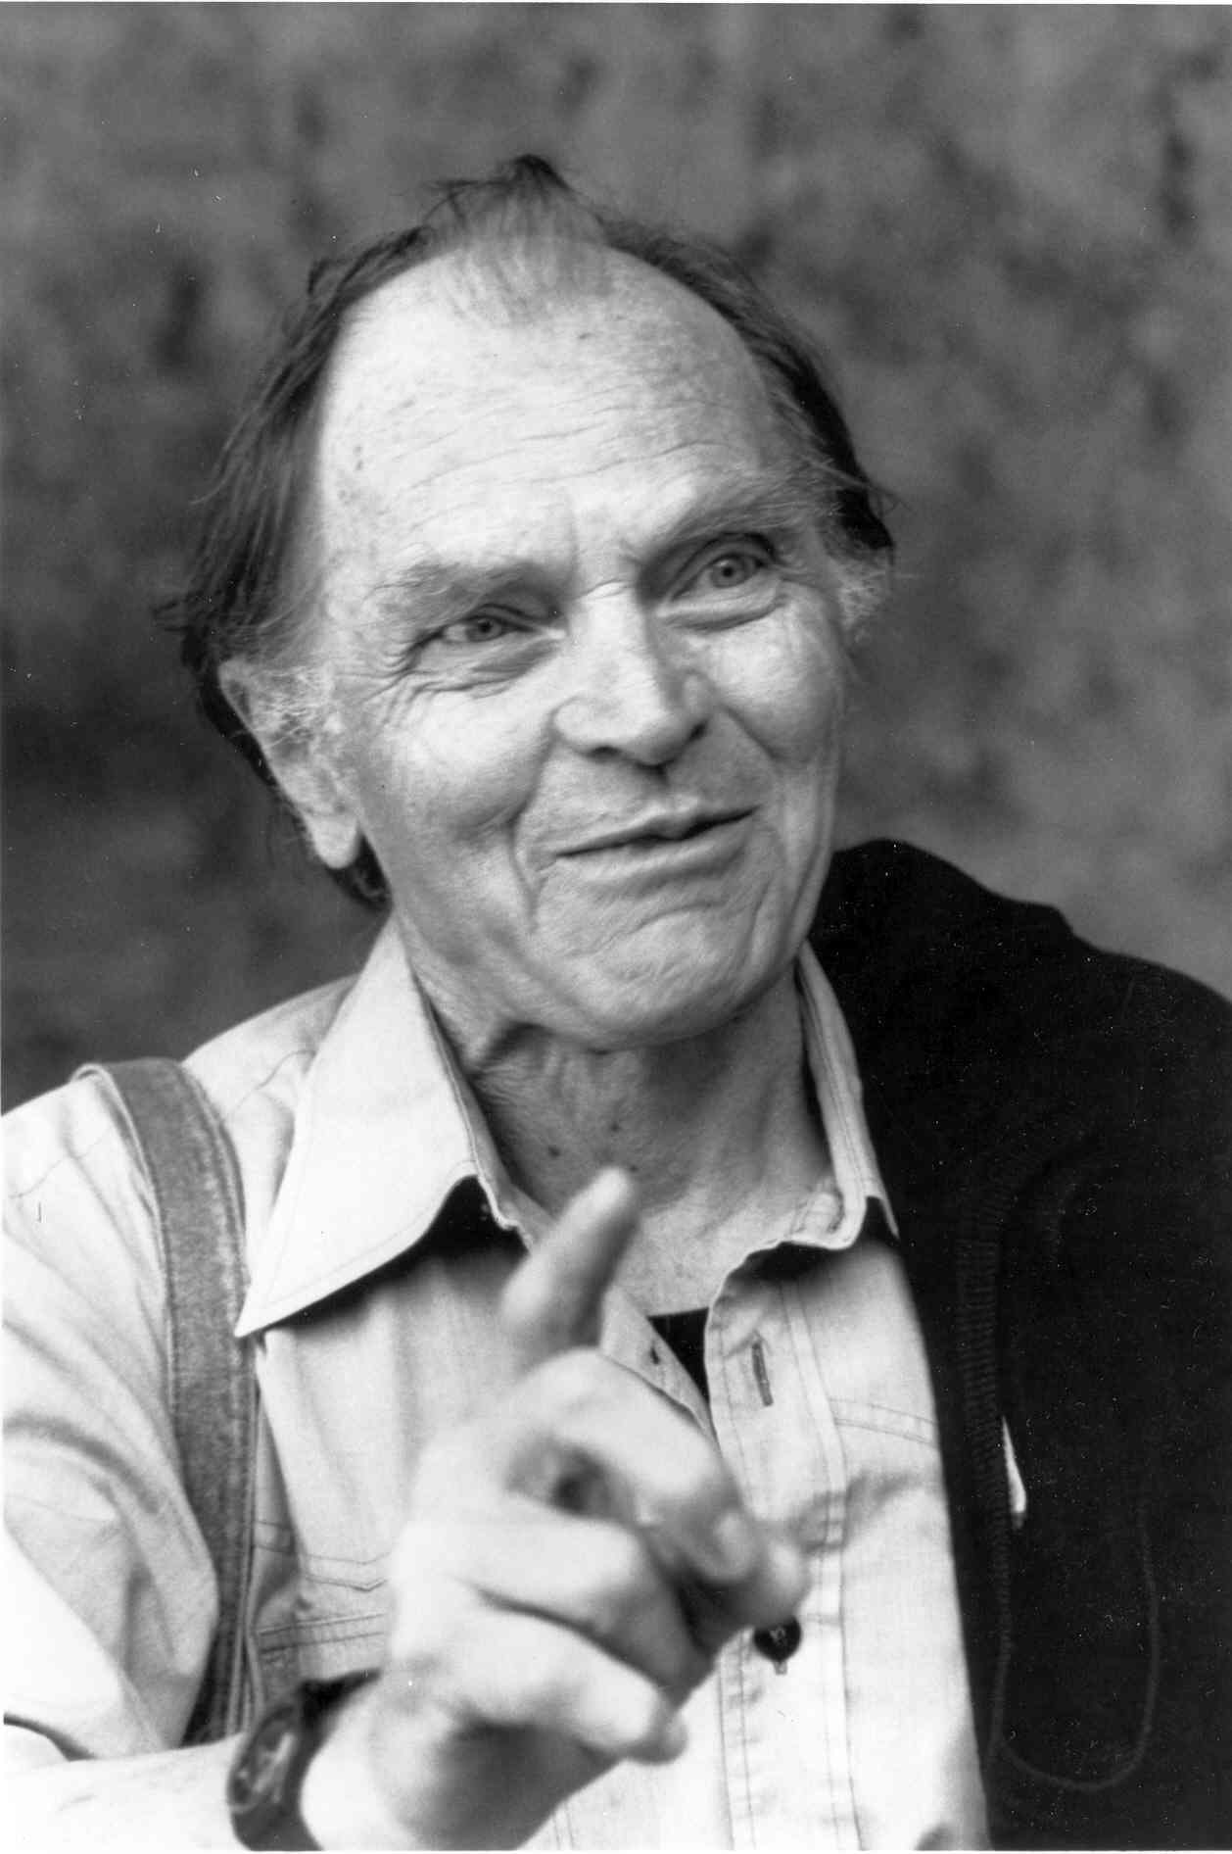

Paul Feyerabend’s anarchist methodology of science
“The idea of a method that contains firm, unchanging, and absolutely binding principles for conducting the business of science meets considerable difficulty when confronted with the results of historical research. We find, then, that there is not a single rule, however plausible, and however firmly grounded in epistemology, that is not violated at some time or other. We find, then, that there is not a single rule, however plausible, and however firmly grounded in epistemology, that is not violated at some time or other. It becomes evident that such violations are not accidental events, they are not results of insufficient knowledge or of inattention which might have been avoided. On the contrary, we see that they are necessary for progress.” AM, Introduction
Paul K. Feyerabend
1924–1994
Against Method: Outline of an Anarchistic Theory of Knowledge
1975

Slide 31
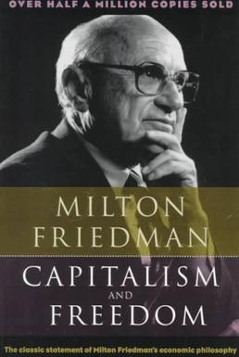
Nobel prize 1976
Among the most influential economists of the 20th century.
Chicago school (student of Frank Knight)
Critic of Keynesianism
Defender of free market economy
Capitalism and Freedom (1962)
Advisor to Nixon, Reagan, Thatcher
Milton Friedman
1912–2006
Exemplary criticism of F.’s free market, laissez-faire orthodoxy:
“But he slipped all too easily into claiming both that markets always work and that only markets work. It's extremely hard to find cases in which Friedman acknowledged the possibility that markets could go wrong, or that government intervention could serve a useful purpose.”
Paul Krugman, Who Was Milton Friedman?
The New York Review of Books, 2007.

Slide 32
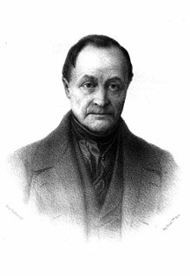
Auguste Comte’s “philosophie positive”
Cours de philosophie positive 1830-1842
Anti-metaphysical, anti-theological
Three stages of social evolution
1) Theological stage
2) Metaphysical stage
3) Positive stage
Positive science: observation-based, rational, empirical, statistical
French mathematician and philosopher
Founder (among others) of empirical sociology
Founder of positivism
Cours de philosophie positive 1830-1842
Precursor of 20th century neo-positivism
Auguste Comte
(1798-1857)

Slide 33
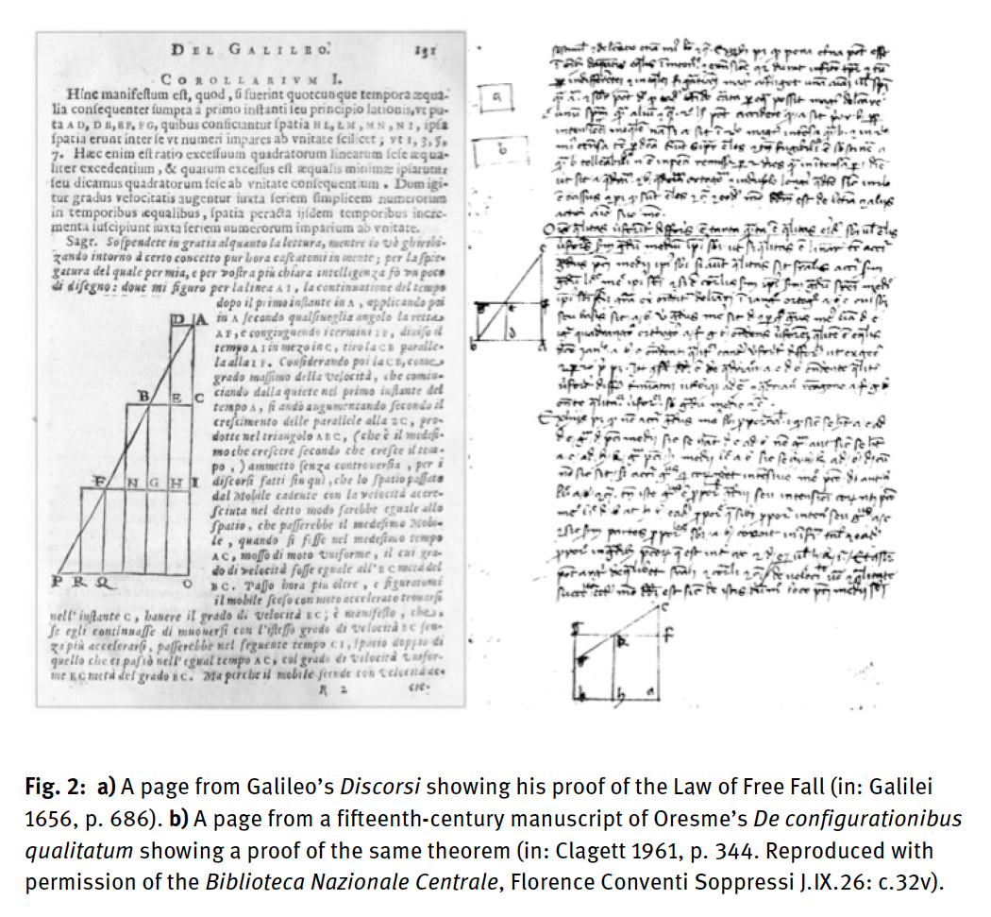
Galileo’s law of free fall
s=1/2gt²

Slide 34
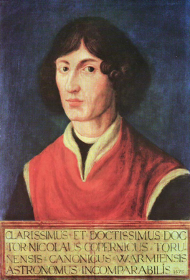
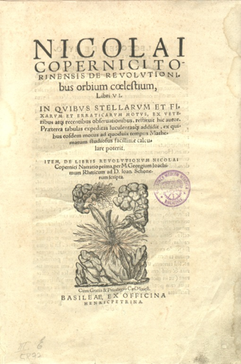
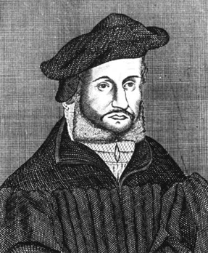
Osiander’s Foreword to
Copernicus’ De revolutionibus orbium coelestium (1543)
To the Reader Concerning the Hypotheses of this Work
There have already been widespread reports about the novel hypotheses of this work, which declares that the earth moves whereas the sun is at rest in the center of the universe. Hence certain scholars, I have no doubt, are deeply offended and believe that the liberal arts, which were established long ago on a sound basis, should not be thrown into confusion. But if these men are willing to examine the matter closely, they will find that the author of this work has done nothing blameworthy. For it is the duty of an astronomer to compose the history of the celestial motions through careful and expert study. Then he must conceive and devise the causes of these motions or hypotheses about them. Since he cannot in any way attain to the true causes, he will adopt whatever suppositions enable the motions to be computed correctly from the principles of geometry for the future as well as for the past. The present author has performed both these duties excellently. For these hypotheses need not be true nor even probable. On the contrary, if they provide a calculus consistent with the observations, that alone is enough.
Copernicus
1473 – 1543
Instrumentalism
Andreas Osiander
1498 – 1552

Slide 35
A Typology of Predictions
PREDICTIONS | Probabilistic* | Non-Probabilistic
spatio-temporally indexed (“predictions that, when, where …”) | Local whether predictions Gambling likelihoods in specific situations Election forecasts | Astronomical predictions Ballistics
Not spatio-temporally indexed (“predictions that …”) | Seismological forecasts Global climate predictions Gambling likelihoods generally Risk of disease development in a patient Social-scientific predictions (e.g. the likelihood of war between China and the US) | Inductive generalizations (e.g. “The sun will rise tomorrow”) Prophecies
* Probabilistic predictions can be interpreted subjectively or objectively!

Slide 36
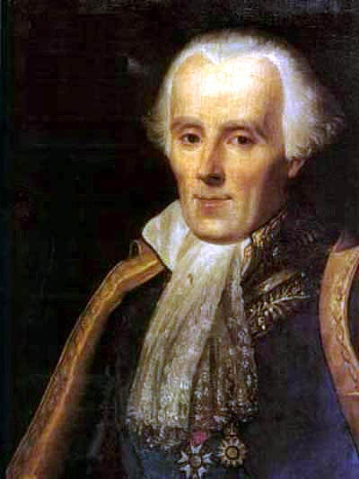
Laplace’s Demon
„Une intelligence qui, à un instant donné, connaîtrait toutes les forces dont la nature est animée et la situation respective des êtres qui la compose embrasserait dans la même formule les mouvements des plus grands corps de l'univers et ceux du plus léger atome; rien ne serait incertain pour elle, et l'avenir, comme le passé, serait présent à ses yeux.“
Essai philosophique sur les probabilités (1814)
Pierre-Simon Laplace (1749–1827)
“Given for one instant an intelligence which could comprehend all the forces by which nature is animated and the respective situations of the beings who compose it – an intelligence sufficiently vast to submit these data to analysis – it would embrace in the same formula both the movements of the greatest bodies of the universe and those of the lightest atom; for it, nothing would be uncertain, and the future, as the past, would be present to its eyes.”

Slide 37
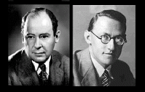
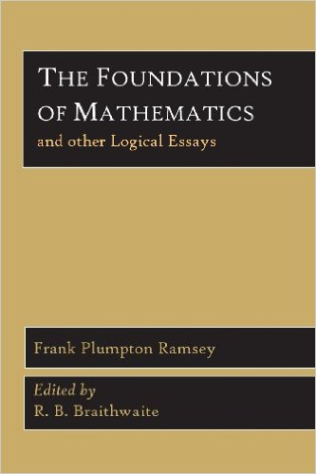
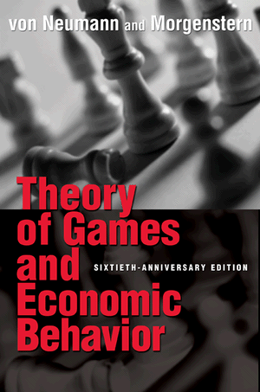
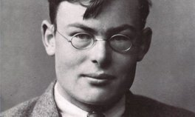
1931
John von Neumann & Oskar Morgenstern
Frank P. Ramsey
1944

Slide 38
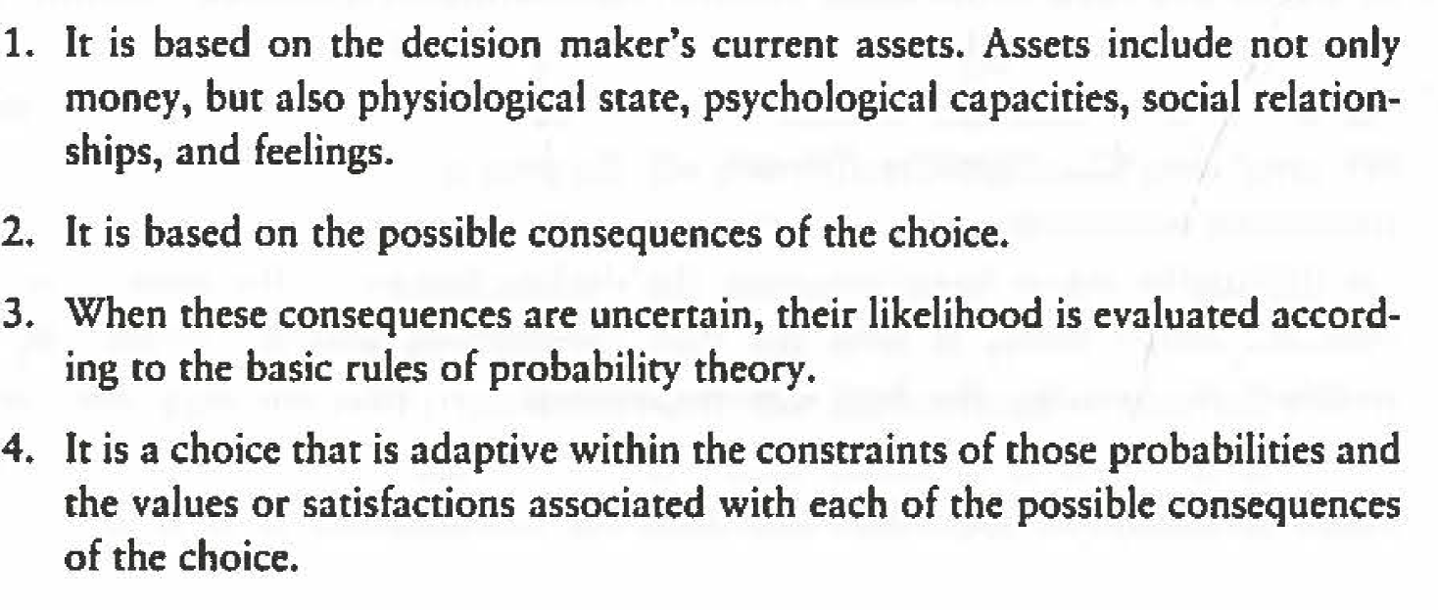
Def.: Rational Choice
Hastie & Dawes, Rationality (pp. 16-17)

Slide 39
Def. Expected Value:
Probability of the event x value of outcome
Def. Utility:
Value of outcome given personal preferences
Def. Expected Utility:
∑ (probability_{i} x utility_{i}) for each alternative course of action
Hastie & Dawes: Rationality (pp. 17-31)

Slide 40
Theory
Data
Prediction
Model
Real World Target System

Slide 41
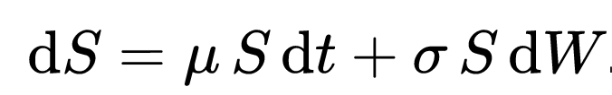
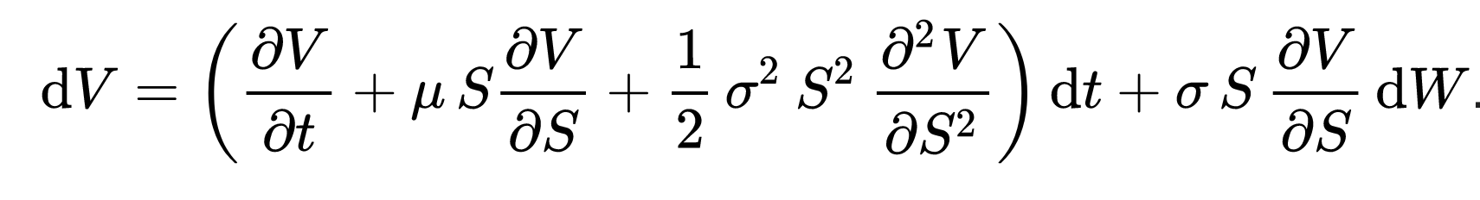
The Black-Scholes Model
Assumptions of the model:
The price of the base follows a geometric Brownian motion with constant drift and volatility
There exists a risk-free interest rate
The stock does not pay a dividend
Assumptions about the market:
There is no arbitrage opportunity
Transactions do not incur any fees or costs
It is possible to borrow and lend any amount of cash at the riskless rate.
It is possible to buy and sell any amount, even fractional, of the stock
Expected profit
Volatility
Base price
Stochastic Term
Option price

